Slide 1


Operating System
Prof. Niikunj Bhavsar, Assistant Professor
Computer Science & Engineering

Slide 2
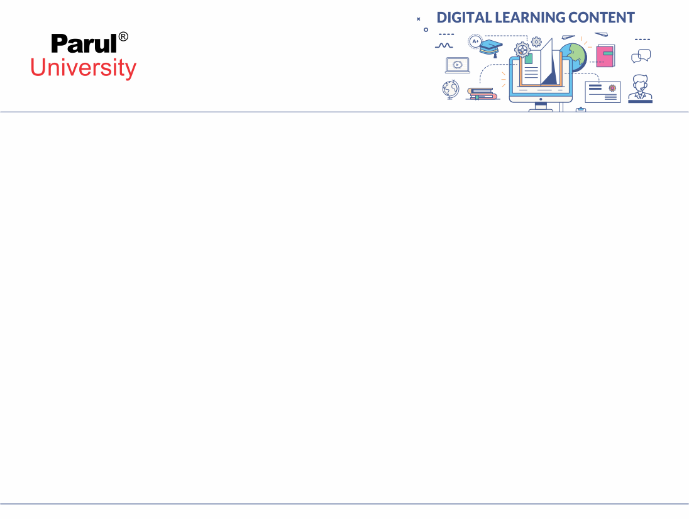

CHAPTER-6
Introduction to Spring Boot

Slide 3
Spring Frame Work
POJO
Dependency Injection
MVC
REST
Security
Batch
Data
AOP
.....
Integrate with Hibernate and Struts

Slide 4


Introduction to spring boot
Developer
Spring Boot
Spring Frame work

Slide 5
Introduction to spring boot
Rapid development of stand-alone applications
Simplified configuration (Convention over Configuration)
Embedded servers for easy deployment
Production-ready features (health checks, metrics)

Slide 6
Introduction to spring boot
Starting of spring boot web application
Spring -boot-starter-web
Spring-boot-starter-jdbc
Application.properties

Slide 7
Spring Ecosystem Overview:
Spring Core
Spring MVC (Web)
Spring Data (Database)
Spring Security
Spring Cloud (Microservices)
Demo: Creating a "Hello World" REST API with Spring Boot

Slide 8
Introduction to spring boot
1)Dependency Injection
2)Autowire
3)Web App using spring boot
4)Spring Boot AOP
5)Spring Boot Database
6)Spring Rest

Slide 9
What is Spring Framework?
 Spring Framework was created by Rod Johnson(2003) and
released under Apache 2.0 license.
 The most popular application development framework for
enterprise Java
 An Open source Java platform
 Provides to create high performing, easily testable and
reusable code.
 is organized in a modular fashion
 simplifies java development

Slide 10
Spring Framework
Enables Plain Old Java Object (POJO) based programming model
 POJO you don’t need EJB container product
Utilizes existing technologies
ORM frameworks
Logging frameworks
JEE
 Quartz
 JDK timers

Slide 11
Spring Boot Starters
Handling dependency management is a difficult task for big projects.
Spring Boot resolves this problem by providing a set of dependencies for developers convenience.
For example, if you want to use Spring and JPA for database access, it is sufficient if you include spring-boot-starter-data-jpa dependency in your project.
Note that all Spring Boot starters follow the same naming pattern spring-boot-starter-*, where * indicates that it is a type of the application.
Examples
Look at the following Spring Boot starters explained below for a better understanding:
Spring Boot Starter Actuator dependency is used to monitor and manage your application.
Its code is shown below:
<dependency>
<groupId>org.springframework.boot</groupId>
<artifactId>spring-boot-starter-actuator</artifactId>
</dependency>

Slide 12
Example Code ( Hello World REST API):
Java
import org.springframework.boot.SpringApplication;
import org.springframework.boot.autoconfigure.SpringBootApplication;
import org.springframework.web.bind.annotation.GetMapping;
import org.springframework.web.bind.annotation.RestController;
@SpringBootApplication
@RestController
public class HelloWorldApplication {
@GetMapping("/")
public String hello() {
return "Hello, Spring Boot!";
}
public static void main(String[] args) {
SpringApplication.run(HelloWorldApplication.class, args);
}
}

Slide 13
Dependencies :
Class A
Class A uses method of Class B
Class B
Class A is dependent on class B

Slide 14
Dependency Injection
Dependency injection (DI) is a process whereby objects define their dependencies (that is, the other objects with which they work) only through constructor arguments, arguments to a factory method, or properties that are set on the object instance after it is constructed or returned from a factory method.
The container then injects those dependencies when it creates the bean. This process is fundamentally the inverse (hence the name, Inversion of Control) of the bean itself controlling the instantiation or location of its dependencies on its own by using direct construction of classes or the Service Locator pattern.
Code is cleaner with the DI principle, and decoupling is more effective when objects are provided with their dependencies.
The object does not look up its dependencies and does not know the location or class of the dependencies. As a result, your classes become easier to test, particularly when the dependencies are on interfaces or abstract base classes, which allow for stub or mock implementations to be used in unit tests.
DI exists in two major variants: Constructor-based dependency injection and Setter-based dependency injection.

Slide 15
Constructor-based dependency injection
Constructor-based DI is accomplished by the container invoking a constructor with a number of arguments, each representing a dependency. Calling a static factory method with specific arguments to construct the bean is nearly equivalent, and this discussion treats arguments to a constructor and to a static factory method similarly. The following example shows a class that can only be dependency-injected with constructor injection:
public class SimpleMovieLister {
// the SimpleMovieLister has a dependency on a MovieFinder
private final MovieFinder movieFinder;
// a constructor so that the Spring container can inject a MovieFinder
public SimpleMovieLister(MovieFinder movieFinder) {
this.movieFinder = movieFinder;
}
// business logic that actually uses the injected MovieFinder is omitted...
}

Slide 16
Constructor Argument Resolution
Constructor argument resolution matching occurs by using the argument’s type.
If no potential ambiguity exists in the constructor arguments of a bean definition, the order in which the constructor arguments are defined in a bean definition is the order in which those arguments are supplied to the appropriate constructor when the bean is being instantiated.

Slide 17
Dependency Injection
You are free to use any of the standard Spring Framework techniques to define your beans and their injected dependencies.
For simplicity we often find that using @ComponentScan to find your beans, in combination with @Autowired constructor injection works well.
If you structure your code as suggested above (locating your application class in a root package), you can add @ComponentScan without any arguments.
All of your application components ( @Component , @Service , @Repository , @Controller etc.) will be automatically registered as Spring Beans.
Here is an example @Service Bean that uses constructor injection to obtain a required RiskAssessor bean.

Slide 18
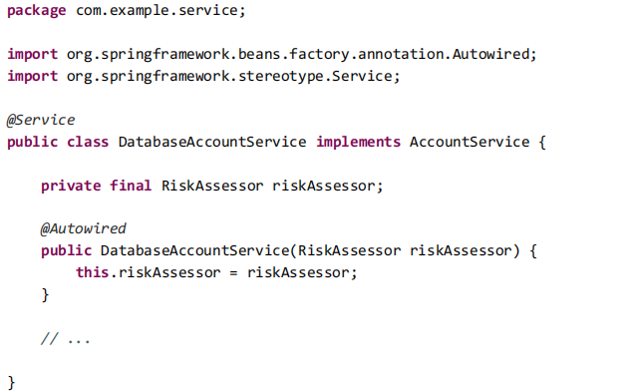
Spring Beans and dependency injection
Notice how using constructor injection allows the riskAssessor field to be marked as final , indicating that it cannot be subsequently changed.

Slide 19
Using the @SpringBootApplication annotation
Many Spring Boot developers always have their main class annotated with @Configuration , @EnableAutoConfiguration and @ComponentScan .
Since these annotations are so frequently used together (especially if you follow the best practices above), Spring Boot provides a convenient @SpringBootApplication alternative.
The @SpringBootApplication annotation is equivalent to using @Configuration , @EnableAutoConfiguration and @ComponentScan with their default attributes:

Slide 20
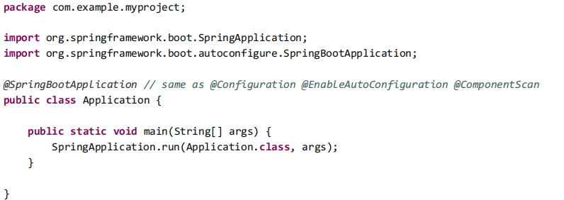
Using the @SpringBootApplication annotation
@SpringBootApplication also provides aliases to customize the attributes of @EnableAutoConfiguration and
@ComponentScan .

Slide 21
Autowiring
1)Autowiring Made Easy
Demonstrate the magic of @Autowired and how it resolves dependencies automatically.
2)Discuss different autowiring modes (byType, byName, constructor).
3)Explain best practices for using autowiring effectively.
4)Bean Configuration Options
Introduce @Component, @Service, @Repository annotations for bean creation.
5)Show how to use @Configuration and @Bean for finer control.
6)Example: Create a "DataRepository" bean and explore different configuration options.

Slide 22
Autowiring
Scenario:
Imagine you're building an online store with Spring Boot. You have a ProductService that needs to interact with a ProductRepository to access product data from a database.
Java program :
@Service
public class ProductService {
private ProductRepository productRepository;
public ProductService() {
this.productRepository = new ProductRepository(); // Manually creating the dependency
}
// ... other methods
}
In this case, the ProductService is tightly coupled to the ProductRepository because it directly creates an instance of it. This makes testing and swapping implementations harder.

Slide 23
Autowiring
Code with Autowiring:
Java
@Service
public class ProductService {
@Autowired // This is where the magic happens!
private ProductRepository productRepository;
// No need for a constructor to create the dependency
// ... other methods
}
Explanation:
@Autowired Annotation: This tells Spring to automatically find a suitable bean of type ProductRepository and inject it into the productRepository field.
Spring's Search: Spring scans all beans in the application context. If it finds a bean that matches the type of productRepository (either by class or interface), it will inject it.
Implicit Wiring: Notice how you no longer need to manually create the ProductRepository in the constructor. Spring does it for you!

Slide 24
Autowiring
How it Works Under the Hood:
Bean Discovery: Spring scans your project for classes annotated with @Component, @Service, @Repository, etc. These are considered as potential candidates for autowiring.
Type Matching: When it encounters @Autowired, Spring looks for a bean whose type matches the field or parameter being injected.
Injection: Spring creates an instance of the matched bean (if not already created) and injects it into the dependent object.
Advantages:
Reduced Boilerplate: Less manual wiring of dependencies.
Improved Testability: Easier to mock dependencies during testing.
Loose Coupling: Easier to swap implementations or introduce new beans without modifying existing code.

Slide 25
Web App using spring boot
The Core Architecture:
Model: Represents application data (usually Java objects).
View: Renders the model data in a user-friendly format (HTML, JSON, etc.).
Controller: Handles incoming requests, processes data, and interacts with the model and view.
Key Annotations:
@Controller: Marks a class as a Spring MVC controller.
@RestController: Used for creating RESTful APIs (returning JSON/XML directly).
@RequestMapping: Maps HTTP requests to controller methods.
@GetMapping, @PostMapping, etc.: Shorthand for @RequestMapping for specific HTTP methods.
Data Binding:
Spring automatically maps request parameters, form data, and JSON/XML to Java objects.
Validation: Ensures data integrity using @Valid and constraint annotations.

Slide 26
Spring Boot for the Web:
Spring Boot simplifies the creation of robust, production-ready web applications.
Why Spring Boot?
Embeds Tomcat, Jetty, or Undertow servers, eliminating the need for external deployments.
Auto-configures Spring MVC and common web components.
Provides starters for various view technologies and REST APIs.
What We'll Build:
A basic CRUD (Create, Read, Update, Delete) application to emonstrate Spring Boot web development.

Slide 27
Building a Spring Boot Web Application
1)Web Development with Spring Boot
2)Introduce Spring MVC for building web applications.
3)Explain the role of @Controller, @GetMapping, @PostMapping, etc.
4)Create a simple web application with a home page, a form, and a response.
5)Thymeleaf Templating
6)Introduce Thymeleaf as a powerful templating engine for generating dynamic HTML.
7)Demonstrate basic Thymeleaf syntax and model-view integration.
Example: Extend the web app to use Thymeleaf for rendering views.

Slide 28
Building a Spring Boot Web Application
Example: Task Management App
We'll create a basic web app that allows users to create, view, update, and delete tasks.
Project Setup:
Create Project: Use Spring Initializr (https://start.spring.io/) to generate a Spring Boot project.
Dependencies: Add the following to your pom.xml:
spring-boot-starter-web
spring-boot-starter-thymeleaf (or your preferred view technology)
spring-boot-starter-data-jpa
h2database (in-memory database for simplicity)

Slide 29
Building a Spring Boot Web Application
Model: Create a Task entity:
Java
@Entity
public class Task {
@Id @GeneratedValue
private Long id;
private String description;
private boolean completed;
// getters, setters, constructor, toString
}

Slide 30
Building a Spring Boot Web Application
Repository: Create a TaskRepository interface extending JpaRepository:
Java
@Repository
public interface TaskRepository extends JpaRepository<Task, Long> {}

Slide 31
Building a Spring Boot Web Application
Controller: Create a TaskController:
Java
@Controller
public class TaskController {
@Autowired
private TaskRepository taskRepository;
@GetMapping("/")
public String listTasks(Model model) {
model.addAttribute("tasks", taskRepository.findAll());
return "task-list"; // Thymeleaf template name
}
// ... other methods for create, update, delete
}

Slide 32
Building a Spring Boot Web Application
Thymeleaf Template (task-list.html)
HTML
<!DOCTYPE html>
<html xmlns:th="http://www.thymeleaf.org">
<head>
<title>Task List</title>
</head>
<body>
<h1>Tasks</h1>
<ul th:each="task : ${tasks}">
<li th:text="${task.description}"></li>
</ul>
</body>
</html>

Slide 33
Building a Spring Boot Web Application
Explanation:
@Controller: Marks the class as a Spring MVC controller.
@Autowired: Injects the TaskRepository into the controller.
@GetMapping("/"): Maps the root URL ("/") to the listTasks method.
listTasks: Fetches all tasks from the repository, adds them to the Model, and returns the name of the Thymeleaf template to render.
Thymeleaf Template: Iterates over the tasks in the model and displays their descriptions.
Running the Application:
Run: Start your Spring Boot application (e.g., mvn spring-boot:run).
Access: Open your browser and navigate to http://localhost:8080/.
You should see a simple webpage listing all the tasks you've added. You can now extend this to implement the create, update, and delete functionality.

Slide 34
Building a CRUD Applicatio:
Demo: Live-code a simple CRUD application that:
Lists all items (GET).
Shows details of a single item (GET).
Creates a new item (POST).
Updates an existing item (PUT/PATCH).
Deletes an item (DELETE).
Tech Stack (Example):
Spring Boot
Thymeleaf (or your choice)
H2 database (or your choice)
Spring Data JPA

Slide 35
Spring Boot AOP (Aspect-Oriented Programming)
What is AOP?
Aspect-Oriented Programming (AOP) is a programming paradigm that complements Object-Oriented Programming (OOP).
OOP: Organizes code into objects based on their relationships.
AOP: Focuses on cross-cutting concerns – functionality that's scattered across multiple classes but serves a single purpose (e.g., logging, security, transaction management).
Goal: AOP aims to modularize these concerns, making your code cleaner, more maintainable, and less repetitive.

Slide 36
Spring Boot AOP (Aspect-Oriented Programming)
Key AOP Concepts:
Aspect: A modular unit of code that encapsulates a cross-cutting concern. It defines:
Pointcut: A predicate (condition) that matches specific points in your program's execution (e.g., method calls, exceptions).
Advice: The action to take when the pointcut is matched (e.g., logging a message, starting a transaction).
Join Point: A specific point in the program's execution where an aspect can be applied (e.g., before or after a method call).
Weaving: The process of incorporating aspects into your code to create a modified version that includes the cross-cutting behavior.
Spring AOP Framework:
Proxy-Based: Spring AOP uses dynamic proxies to intercept method calls and apply aspects.
Annotations: Leverages annotations like @Aspect, @Before, @After, @Around to define aspects and their behavior.
Integration: Seamlessly integrates with other Spring components.

Slide 37
Spring Boot AOP (Aspect-Oriented Programming)
Example: Logging Aspect
Let's create a logging aspect that logs method entry and exit for all methods in a service class:
Aspect Class:
@Aspect
@Component
public class LoggingAspect {
@Before("execution(* com.example.service.*.*(..))")
public void logMethodEntry(JoinPoint joinPoint) {
String methodName = joinPoint.getSignature().getName();
System.out.println("Entering method: " + methodName);
}
@AfterReturning(pointcut = "execution(* com.example.service.*.*(..))", returning = "result")
public void logMethodExit(JoinPoint joinPoint, Object result) {
String methodName = joinPoint.getSignature().getName();
System.out.println("Exiting method: " + methodName + ", Result: " + result);
}
} Enable AOP: In your main Spring Boot application class, add @EnableAspectJAutoProxy.

Slide 38
Spring Boot AOP (Aspect-Oriented Programming)
@Aspect: Marks the class as an aspect.
@Before: Executes the logMethodEntry method before any method in the com.example.service package is called.
@AfterReturning: Executes the logMethodExit method after a successful method execution in the same package.
Pointcut Expression:
execution(* com.example.service.*.*(..)) matches all methods in all classes within the com.example.service package.
JoinPoint:
Provides information about the intercepted method (name, arguments, etc.).
Now, whenever a method in your service class is called, you'll see log messages indicating entry and exit, along with the returned value.

Slide 39
Spring Boot AOP (Aspect-Oriented Programming)
Benefits of Spring AOP:
Improved Modularity: Cross-cutting concerns are separated from core business logic.
Reduced Code Duplication: Aspect code is centralized and reusable.
Better Maintainability: Changes to cross-cutting concerns can be made in one place.

Slide 40
Spring boot Database
Spring Boot drastically simplifies database access in Java applications through these key mechanisms:
Spring Data JPA:
JPA (Java Persistence API):
The standard Java framework for object-relational mapping (ORM). It allows you to work with database entities as plain Java objects.
Spring Data: A higher-level framework built on top of JPA. It reduces boilerplate code for common database operations like CRUD (Create, Read, Update, Delete) through repositories.
Auto-Configuration:
Spring Boot automatically configures JPA and data sources based on your project dependencies and properties.

Slide 41
Spring boot database
Spring JDBC:
Lower-Level Access:
Provides more direct interaction with the database using SQL queries.
Flexibility: Suitable for complex queries or when you need fine-grained control.
Spring Transactions:
Reliability:
Ensures data consistency by grouping multiple database operations into a single unit of work.
Declarative:
Use annotations (@Transactional) to manage transactions without writing boilerplate code.

Slide 42
Example
Example:
Employee Management App
Let's build a simple application to manage employee records using Spring Boot, Spring Data JPA, and an in-memory H2 database.
Project Setup:
Spring Initializr: Use it to generate a Spring Boot project with the following dependencies:
spring-boot-starter-web
spring-boot-starter-data-jpa
h2
application.properties: Add properties for the H2 database:

Slide 43
Example
Properties :
spring.datasource.url=jdbc:h2:mem:testdb
spring.datasource.driverClassName=org.h2.Driver
spring.datasource.username=sa
spring.datasource.password=
spring.jpa.database-platform=org.hibernate.dialect.H2Dialect

Slide 44
Example
Entity:
Create an Employee entity:
Java
@Entity
public class Employee {
@Id @GeneratedValue
private Long id;
private String name;
private String email;
// getters, setters, constructor, toString
}

Slide 45
Example
Entity -----Create an Employee entity:
@Entity
public class Employee {
@Id @GeneratedValue
private Long id;
private String name;
private String email;
// getters, setters, constructor, toString
}
Repository:
Create an EmployeeRepository interface:
Java
@Repository
public interface EmployeeRepository extends JpaRepository<Employee, Long> {}

Slide 46
Example
Controller:
Create an EmployeeController to handle RESTful requests:
Java
@RestController
@RequestMapping("/api/employees")
public class EmployeeController {
@Autowired
private EmployeeRepository employeeRepository;
@GetMapping
public List<Employee> getAllEmployees() {
return employeeRepository.findAll();
}
// ... other methods for create, update, delete
}

Slide 47
Example
Explanation:
Entity: The Employee class represents a table in the database. Each instance is a row.
Repository: The EmployeeRepository provides CRUD operations for Employee entities. You don't need to write SQL queries manually!
Controller: The EmployeeController exposes REST endpoints to interact with employees.
Running the Application:
Start the Spring Boot application.
Use a REST client (e.g., Postman) or your browser to access the endpoints:
GET /api/employees: Get all employees.
POST /api/employees: Create a new employee.
PUT /api/employees/{id}: Update an employee.
DELETE /api/employees/{id}: Delete an employee.

Slide 48
Example
Points to remember :
Spring Boot Starters: Simplify dependency management and configuration.
Auto-Configuration: Eliminates manual setup for JPA and data sources.
Spring Data JPA: Provides a powerful repository abstraction.
H2 Database: Easy to set up for development and testing.

Slide 49
Spring Boot REST APIs
What is REST?
Representational State Transfer (REST): An architectural style for building web services that leverage the HTTP protocol's features.
Key Principles:
Client-Server: Separates concerns of UI (client) and data storage/processing (server).
Stateless: Each request is independent and contains all necessary information.
Cacheable: Responses can be cached to improve performance.
Layered System: Allows for intermediaries (load balancers, security layers) between client and server.
Uniform Interface: Resources are identified by URIs, and standard HTTP methods (GET, POST, PUT, DELETE) are used for operations.
Code on Demand (Optional): Allows clients to download and execute code from the server.

Slide 50
Spring Boot REST APIs
Spring's REST Support:
Spring provides excellent tools and abstractions for building RESTful APIs:
Spring MVC: The foundation for building web applications and RESTful services.
@RestController: A specialized controller annotation that simplifies the creation of REST endpoints.
@RequestMapping (and variants): Maps HTTP requests to controller methods based on URLs and HTTP methods.
Data Conversion: Automatically converts Java objects to JSON or XML (and vice-versa) using libraries like Jackson or JAXB.
Exception Handling: Provides mechanisms to handle exceptions gracefully and return appropriate error responses.
Hateoas (Hypermedia as the Engine of Application State): Can be used to add links to responses, guiding clients on how to interact with the API.

Slide 51
Spring Boot REST APIs
Example: Library API
Let's build a simple REST API for a library that manages books.
Entity (Book):
Java
@Entity
public class Book {
@Id @GeneratedValue
private Long id;
private String title;
private String author;
// getters, setters, constructor, toString
}

Slide 52
Spring Boot REST APIs
Repository:
@Repository
public interface BookRepository extends JpaRepository<Book, Long>
{
}
}

Slide 53
Spring Boot REST APIs
Controller:
@RestController
@RequestMapping("/api/books")
public class BookController {
@Autowired
private BookRepository bookRepository;
@GetMapping
public List<Book> getAllBooks() {return bookRepository.findAll();
}
@GetMapping("/{id}")
public Book getBookById(@PathVariable Long id) {
return bookRepository.findById(id)
.orElseThrow(() -> new ResourceNotFoundException("Book not found"));
} // ... other methods for create, update, delete

Slide 54
Spring
Explanation:
@RestController: Marks the class as a REST controller (no need for view resolution).
@RequestMapping("/api/books"): Sets the base URL for all endpoints in this controller.
@GetMapping: Maps GET requests to the corresponding methods.
@PathVariable: Extracts the id from the URL.
Error Handling: We throw a ResourceNotFoundException if the book is not found. You can create a global exception handler to customize error responses.

Slide 55
Spring
Explanation:
@RestController: Marks the class as a REST controller (no need for view resolution).
@RequestMapping("/api/books"): Sets the base URL for all endpoints in this controller.
@GetMapping: Maps GET requests to the corresponding methods.
@PathVariable: Extracts the id from the URL.
Error Handling: We throw a ResourceNotFoundException if the book is not found. You can create a global exception handler to customize error responses.

Slide 56
Spring
Running the Application:
Start the Spring Boot application.
Use a REST client (e.g., Postman, curl) to test the endpoints:
GET /api/books: Get all books.
GET /api/books/1: Get the book with ID 1.
POST /api/books: Create a new book (provide JSON data in the request body).
PUT /api/books/1: Update the book with ID 1.
DELETE /api/books/1: Delete the book with ID 1.

Slide 57
Spring
Points to Remember :
HTTP Methods: Use GET, POST, PUT, DELETE for the standard CRUD operations.
Resource Identification: Use meaningful URLs to identify resources (e.g., /api/books).
Status Codes: Return appropriate HTTP status codes (e.g., 200 OK, 404 Not Found).
Content Negotiation: Consider supporting multiple response formats (JSON, XML).
Security: Always implement security measures to protect your APIs.
This is a basic example. You can enhance it by adding pagination, filtering, sorting, and other features to build more comprehensive REST APIs. Let me know if you have any more questions.
.

Slide 58


www.paruluniversity.ac.in

